Slide 1




SALARY SURVEY ANALYSIS
BY:
YASHWANTH K
DA & DS NOV
10/02/2025

Slide 2
PROJECT OBJECTIVE
The objective of this project :
To analyze salary trends
Experience levels
Compensation patterns across industries
Using SQL and Excel :
We Should extract insights to understand salary distribution by factors like gender, education, industry, job title, and location.

Slide 3
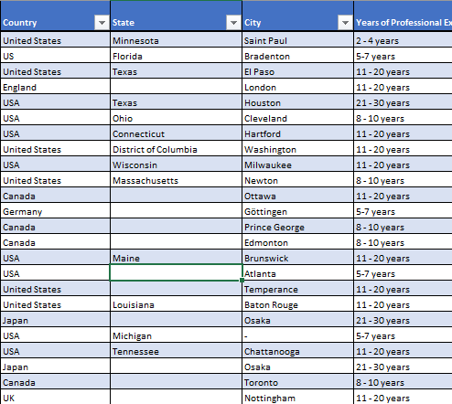
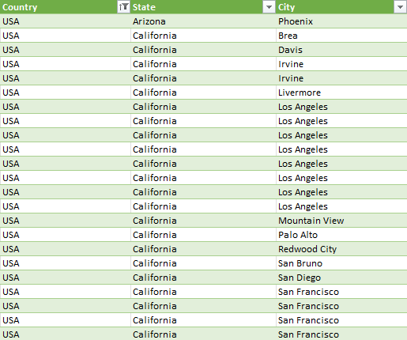
DATA CLEANING AND PREPARATION
RAW DATA - 28100
CLEANED DATA - 27932

Slide 4
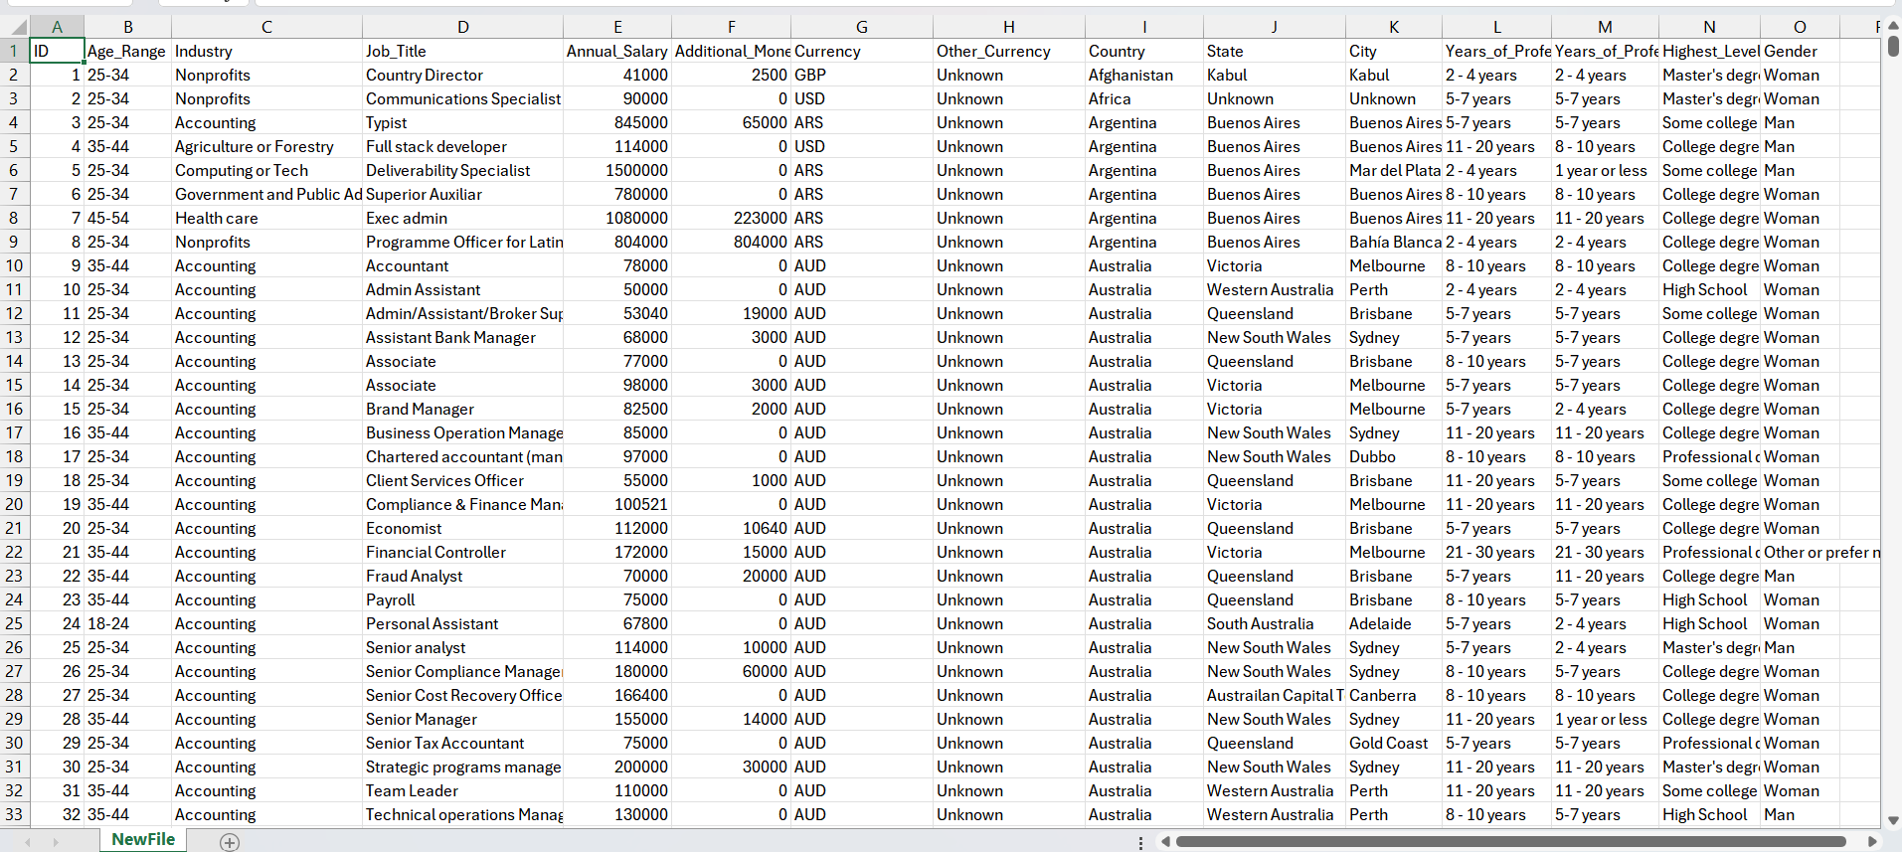
CSV FILE FOR SQL IMPORT

Slide 5
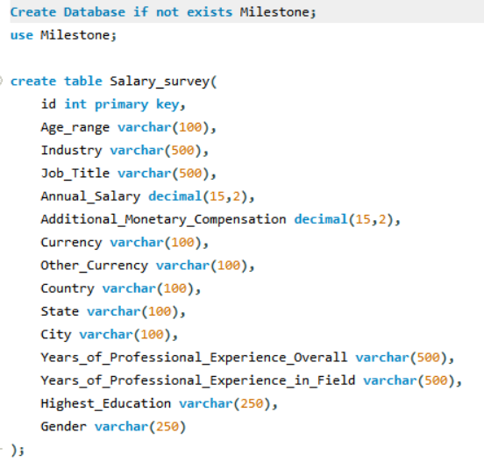
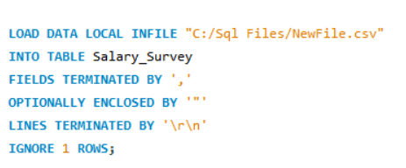
DATA IMPORT INTO SQL

Slide 6
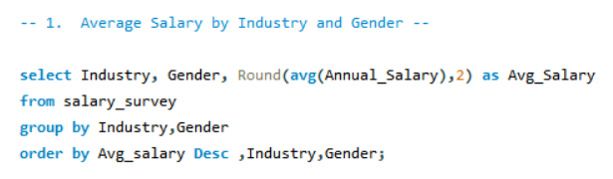
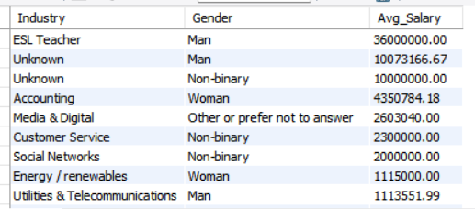
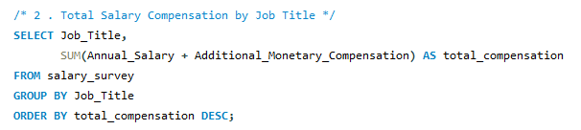
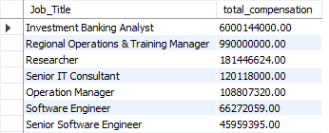
SQL QUERIES
QUERY
OUTPUT

Slide 7
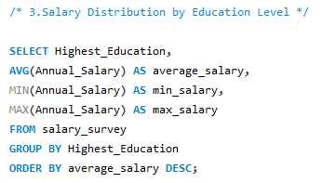
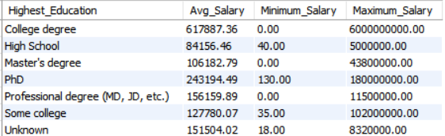
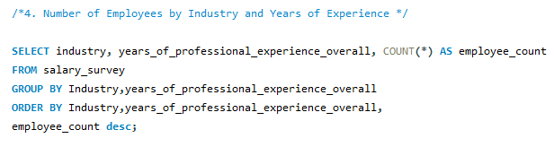
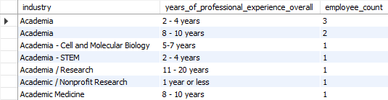
SQL QUERIES
OUTPUT
QUERY

Slide 8
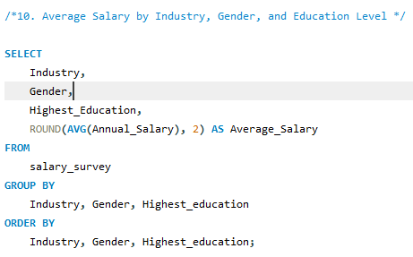
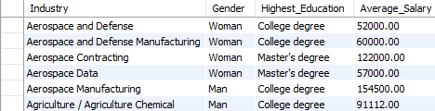
SQL QUERIES
QUERY
OUTPUT

Slide 9
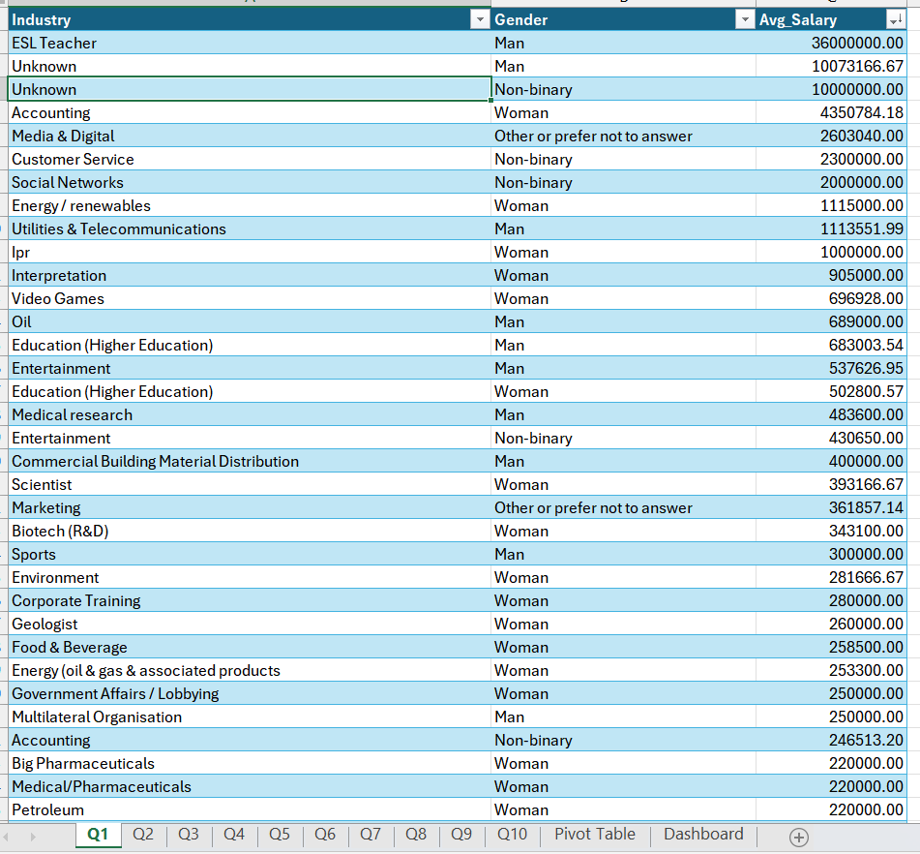

DATA EXPORT

Slide 10
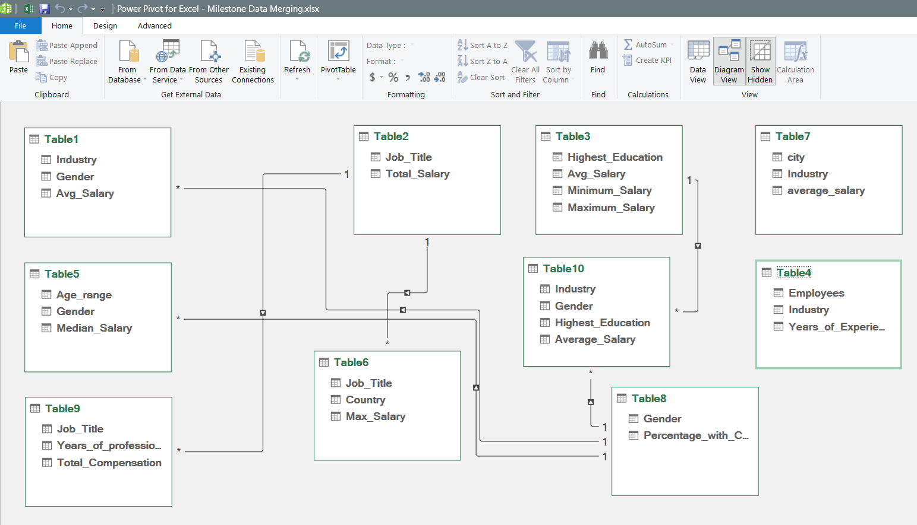
TABLE RELATIONSHIP

Slide 11
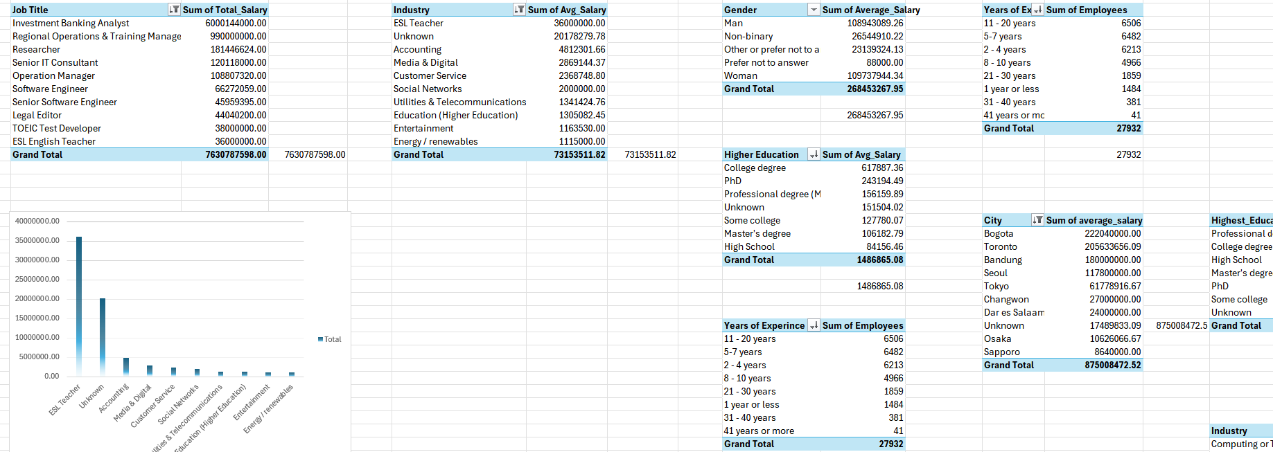
PIVOT TABLES

Slide 12
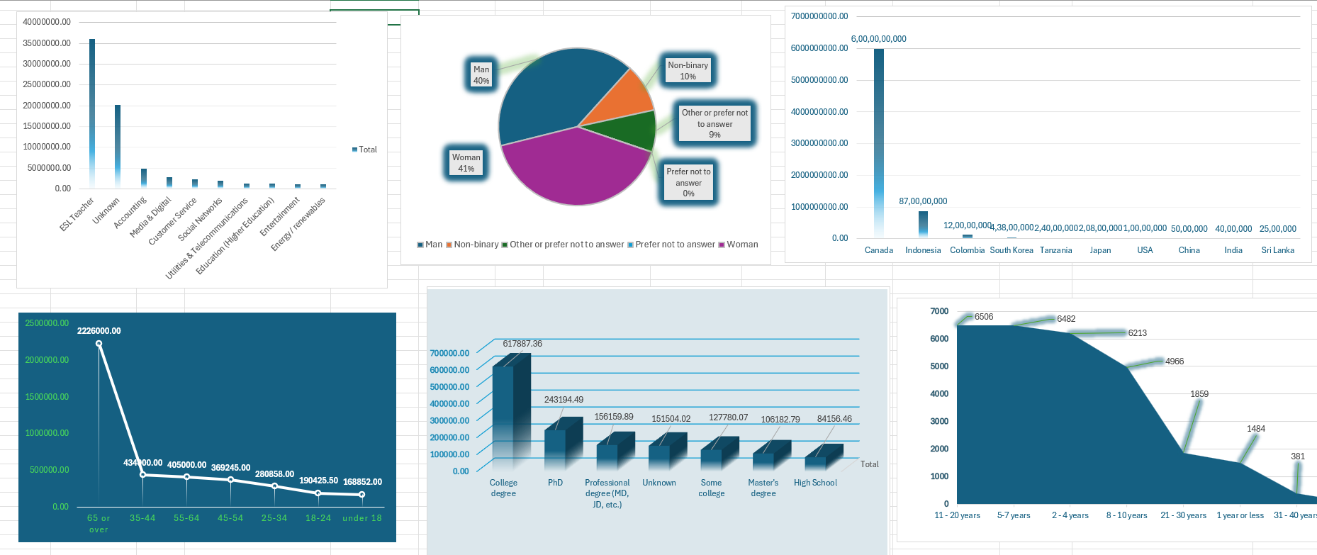
PIVOT CHARTS

Slide 13
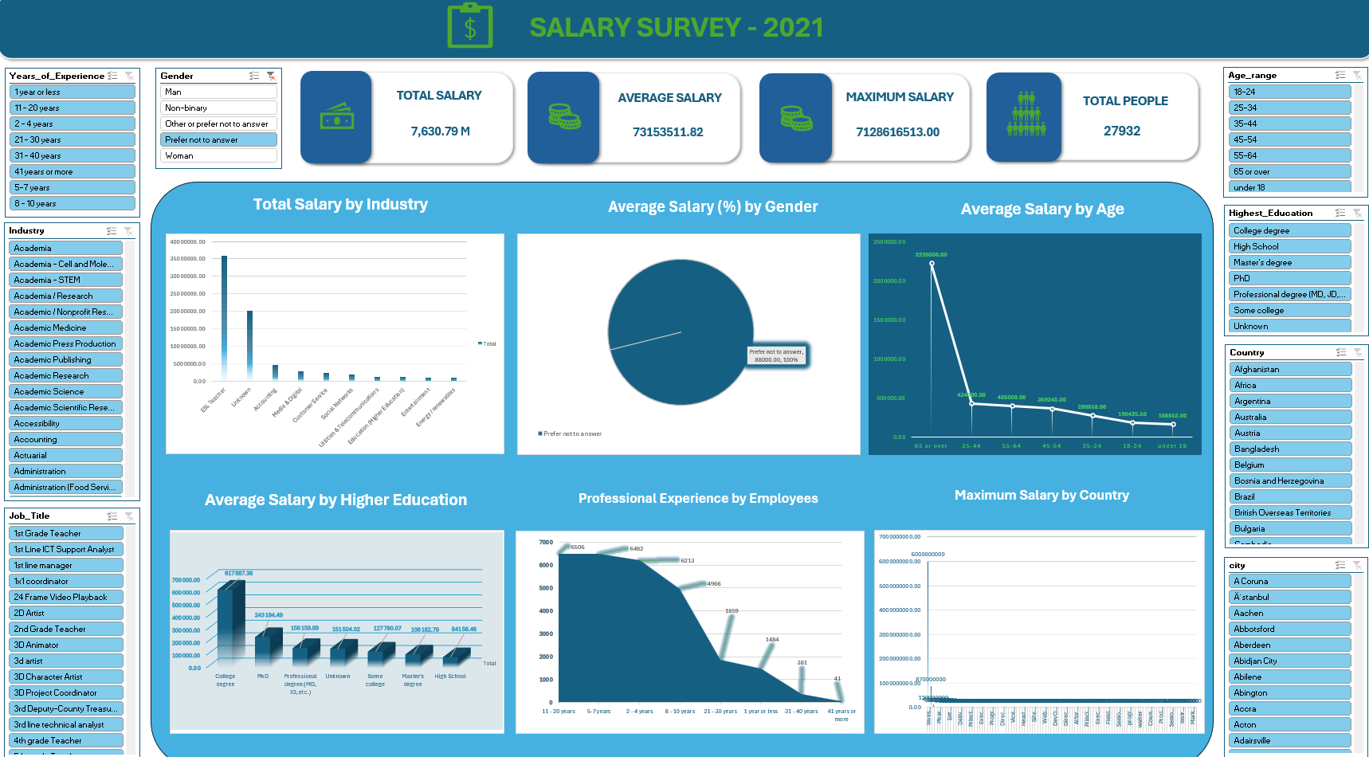
DASHBOARD

Slide 14
INSIGHTS AND CONCLUSION
Job Title → Investment Banking Analyst - 6000144000.00 || BI Consultant - 10.00
Industry → ESL Teacher - 36000000.00 || Environmental Regulation - 58.00
Gender → Average Salary → Woman - 109737944.34 || Prefer not to answer - 88000.00
Gender → Count → Woman - 21267 || Man – 5458 || Non – Binary – 743.
Country → Highest Salary – Canada || Least Salary - Srilanka.
Average Salary → Age Range → 65 and above - 22L || Under 18 - 1.6L

Slide 15


